Slide 1
Mr. William B. Nelson Deputy to the Commanding General
ARMY FUTURES COMMAND
8 August 2023

Slide 2
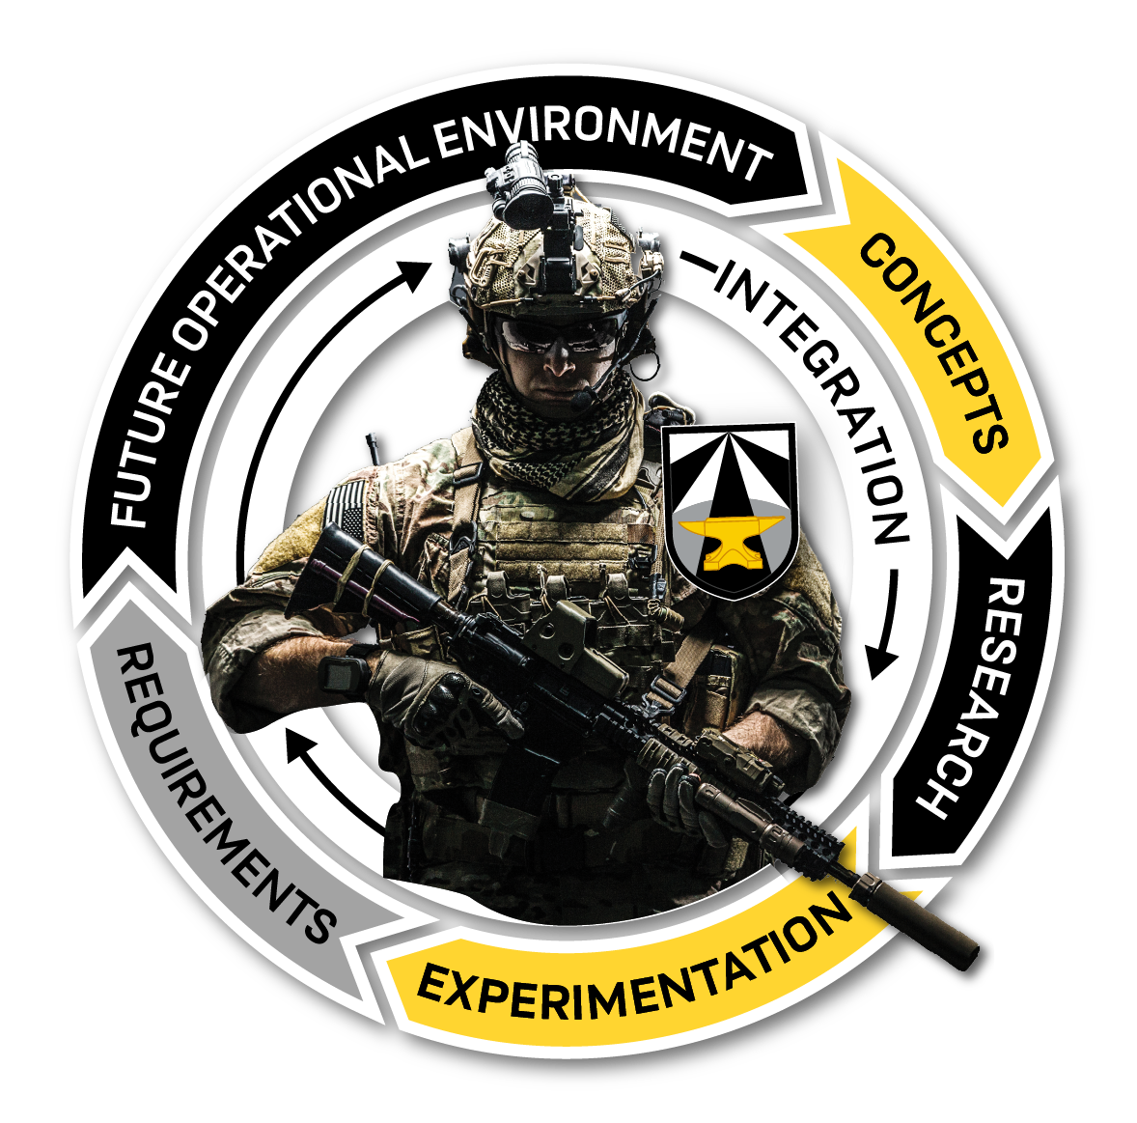
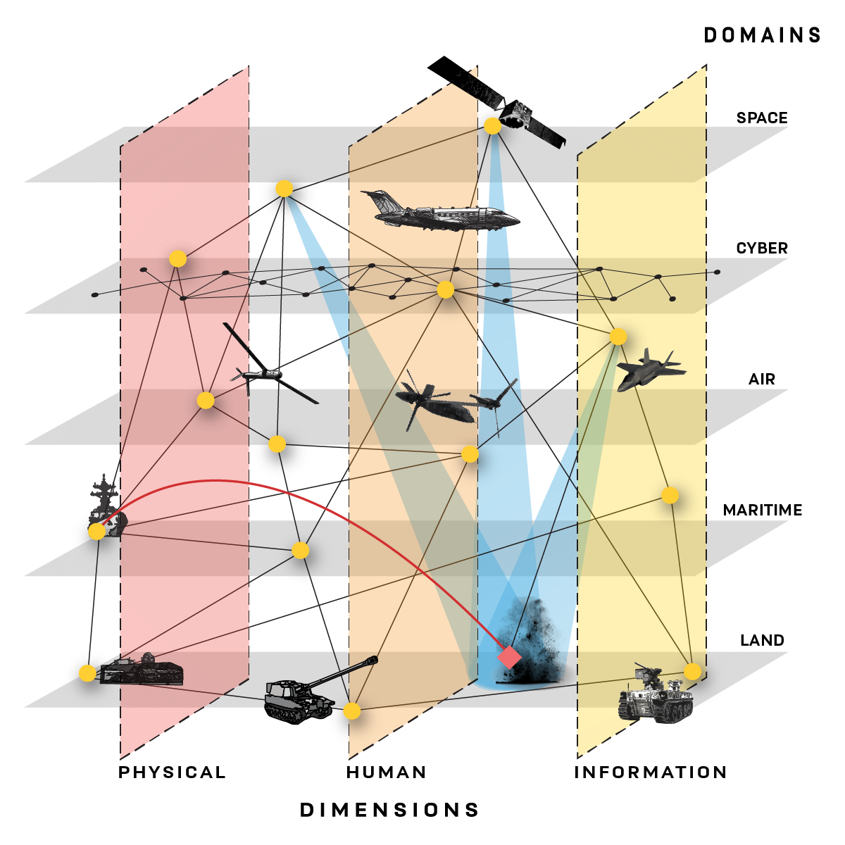
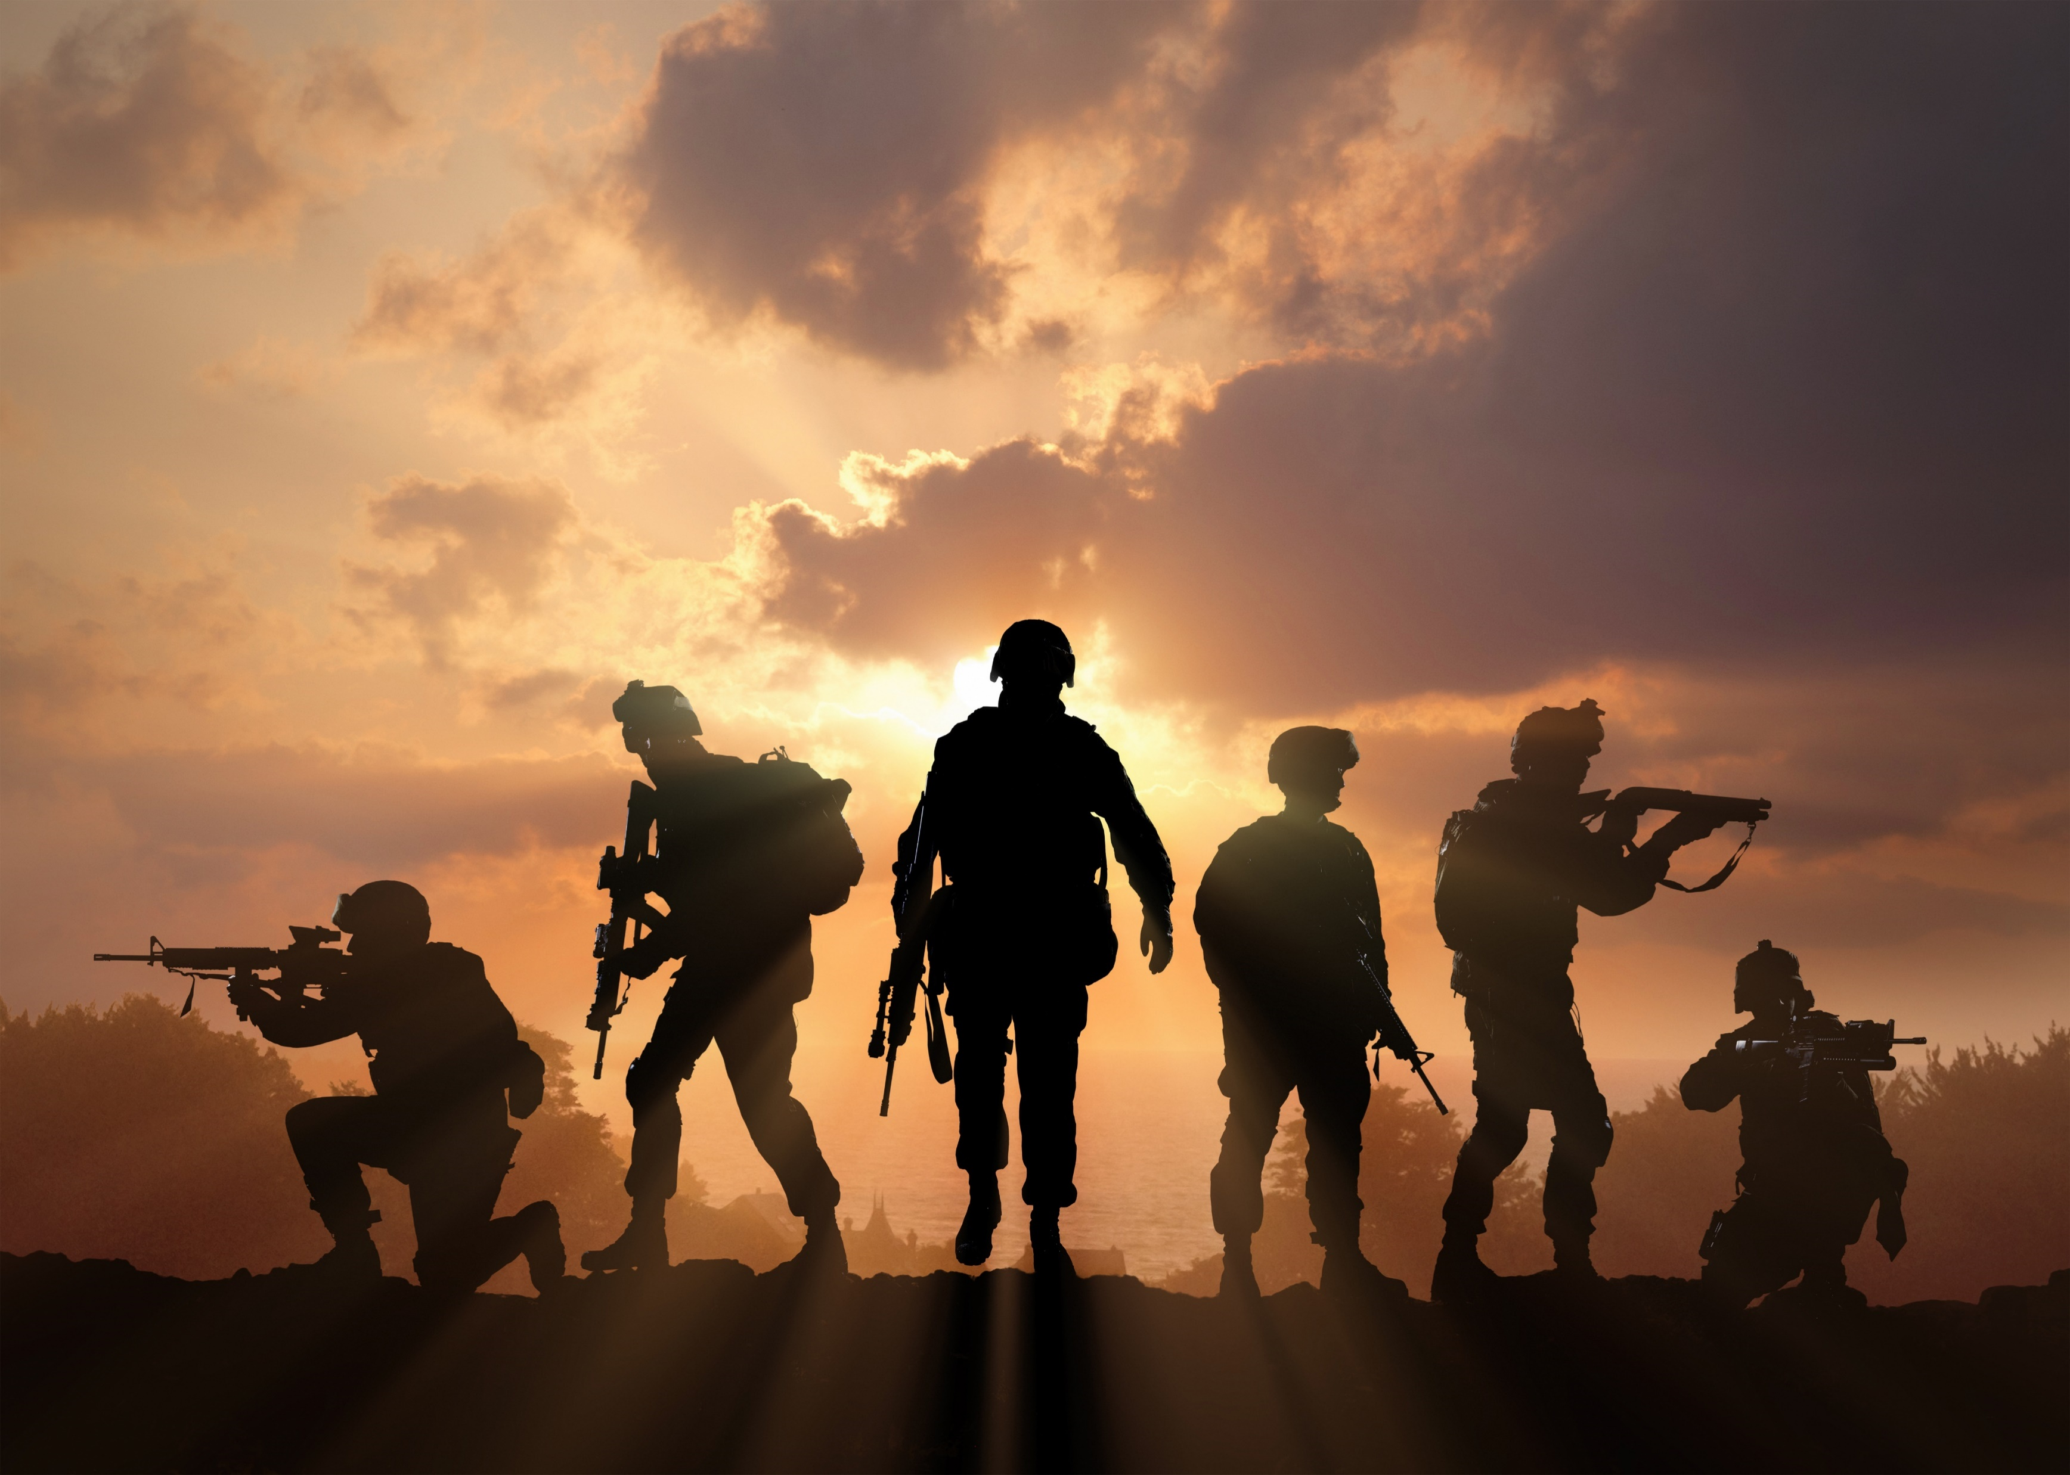
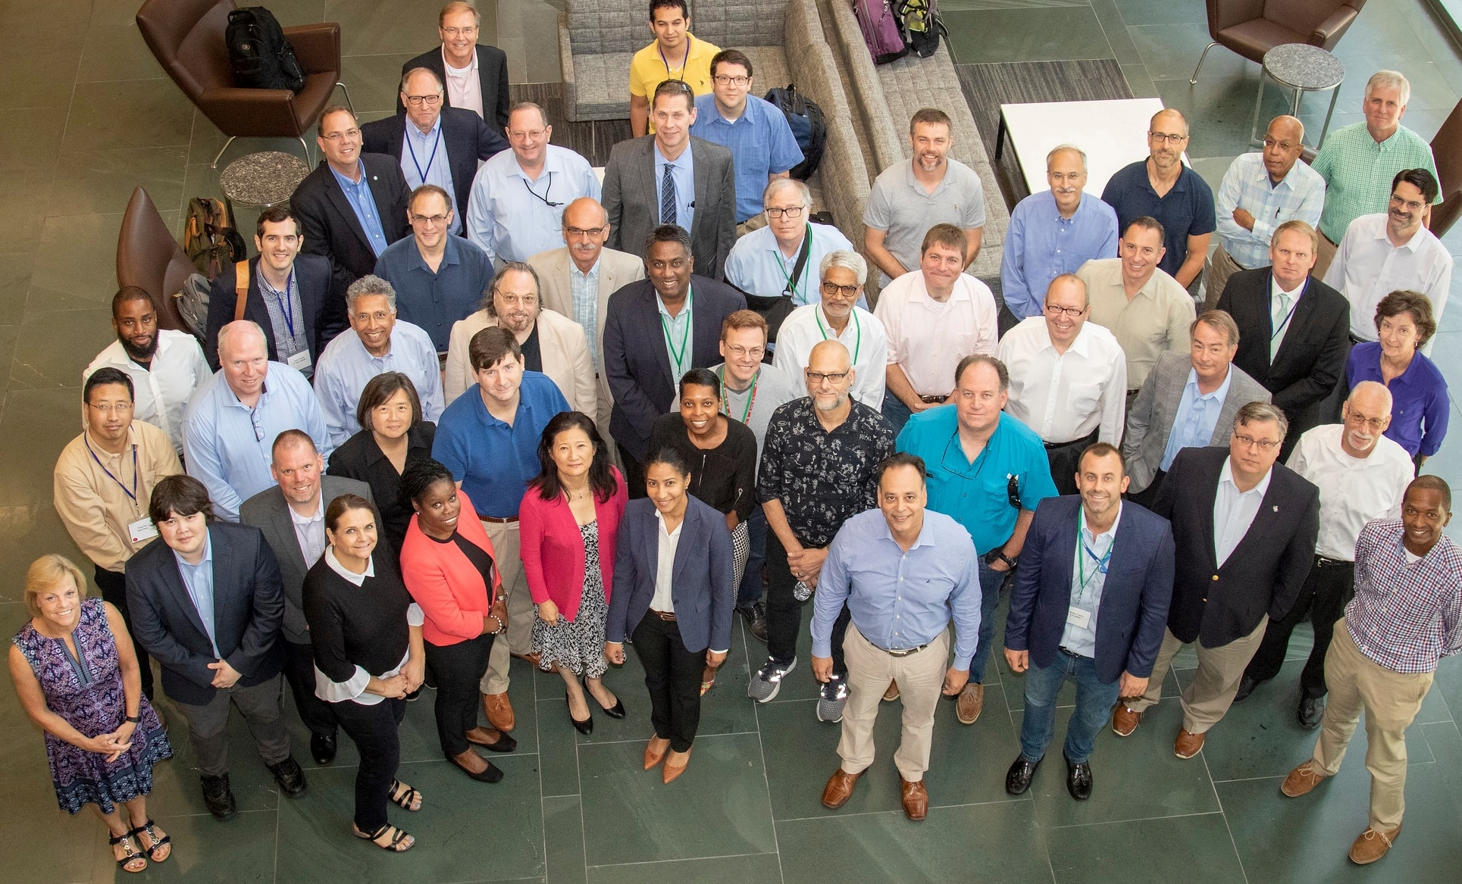
Three Priorities
Six Functions
People
Design
2040
Deliver
2030

Slide 3
UNCLASSIFIED

Slide 4
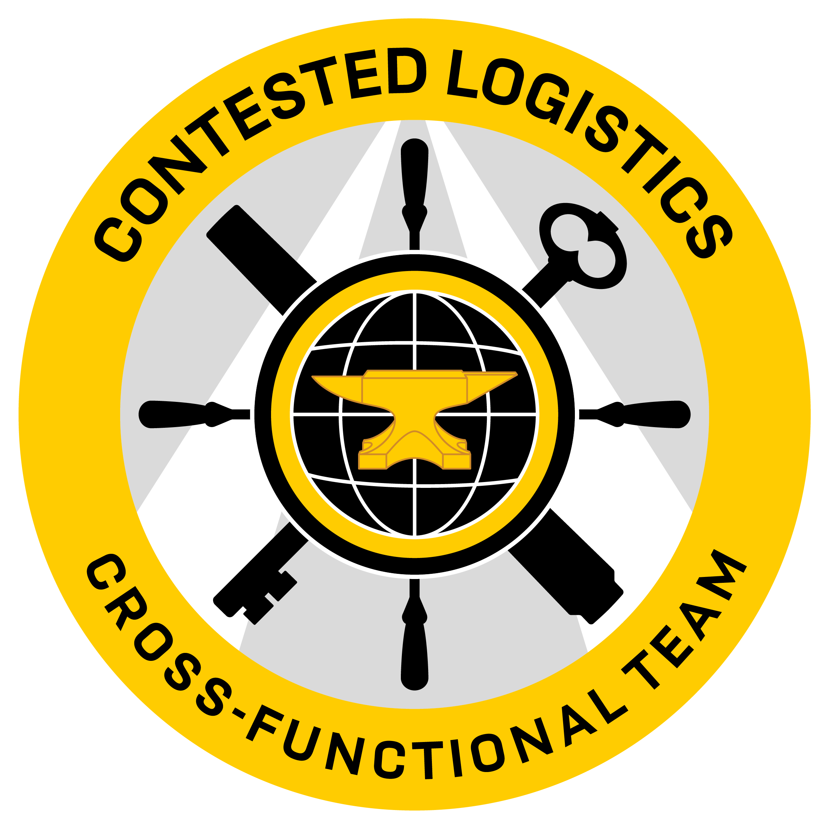
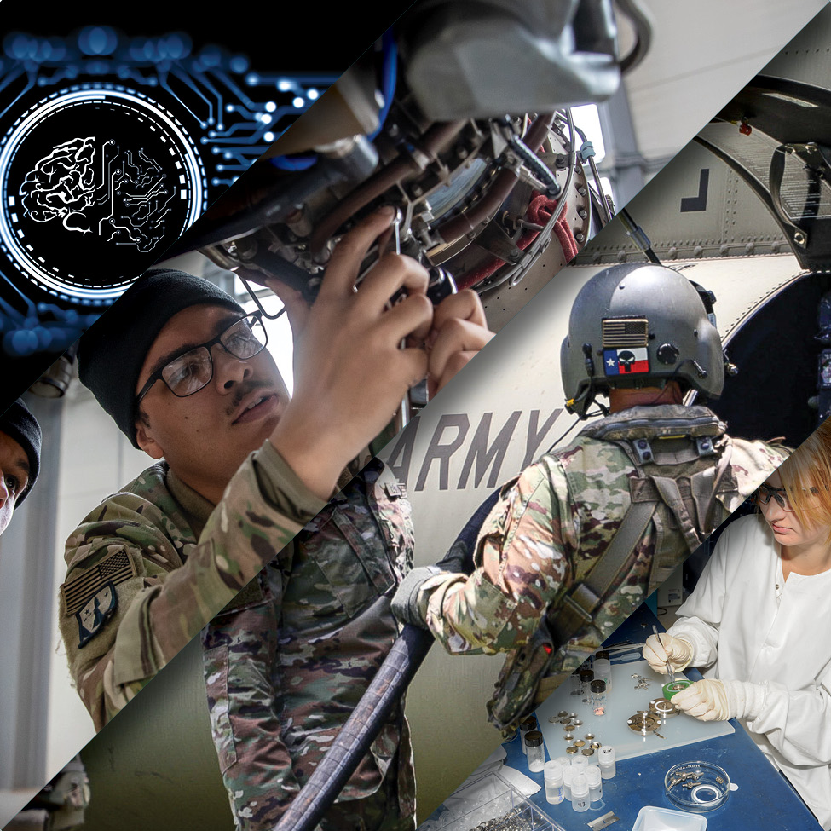
Contested Logistics Cross-Functional Team
RECOMMENDED
PORTFOLIO
Precision Sustainment
Rapid, data-driven, resilient capabilities that execute precision sustainment in a contested environment
Leverages Artificial Intelligence (AI) and Machine Learning (ML) enabling precision sustainment & msn command decision support
The backbone of Sensor to Shooter to Sustainer
Demand Reduction
Energy efficiencies, through hybrid engines and alternative fuels
Meet requirements at the point of need reducing delivery times and burdens on the distribution network
Explore materials that reduce weight
Distribution Platforms
Manned & Unmanned (ground, air, water) platforms to move effectively from the point-of-origin to the point-of-need
Automated machinery to improve the efficiency of logistics operations (i.e., automated port & fuel operations)
Advanced Power
Reduce consumable demand, including liquid fuel and batteries
New energy technologies and efficiencies such as electric propulsion, hydrogen, and other sustainable fuel technologies

Slide 5
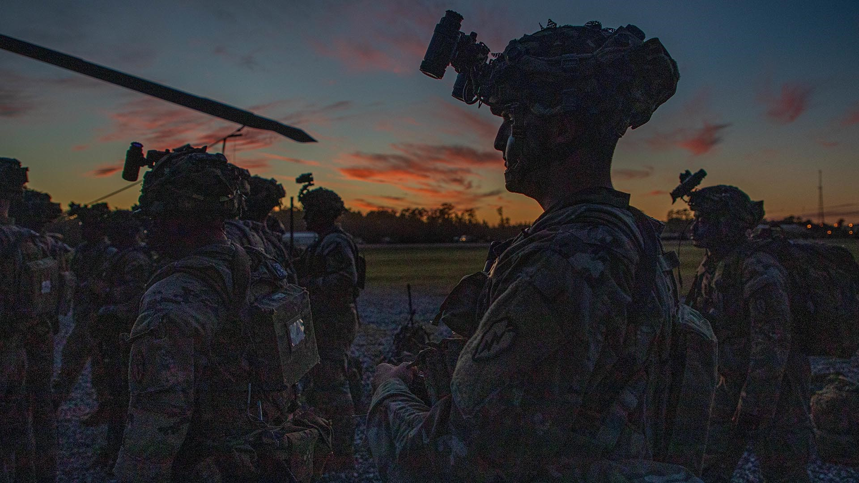
SPACE&MISSILE
DEFENSE
Army Transformation
We are undertaking the greatest and most complex modernization and transformation of our air and missile defense capability since the Cold War, centered on connecting sensors, shooters, and a common mission command.

Slide 6
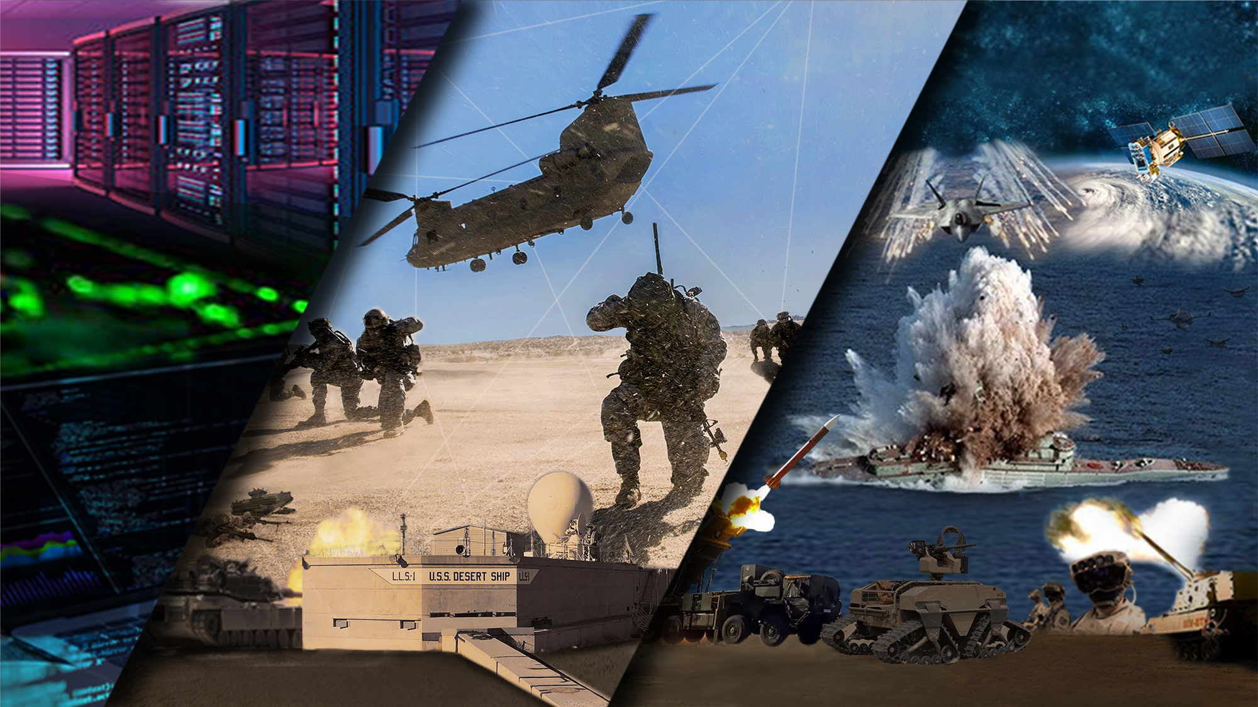
A JOINT CAMPAIGN OF LEARNING
PROJECT CONVERGENCE MAKES IT REAL
"SPEED, RANGE, AND CONVERGENCE OF CROSS-CUTTING TECHNOLOGIES TO PROVIDE DECISION DOMINANCE AND ACHIEVE OVERMATCH.”
GEN JAMES MCCONVILLE, CHIEF OF STAFF OF THE ARMY

Slide 7
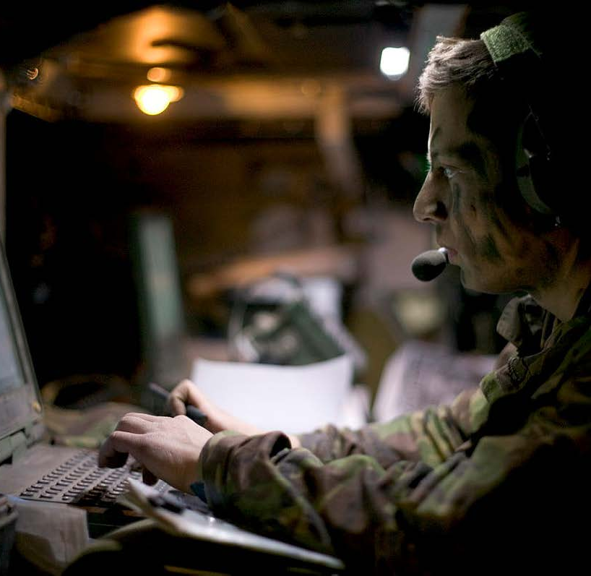
FIVE
CHALLENGES
Observations and implications for future JOINT & COALITION LAND warfare
Employ a formation-based approach to lethality and survivability
Increase the lethality and survivability of our light formations
Decrease the weight and sustainment tails of our heavy formations
Integrate machines into tactical formations
Field a data-centric C2 system for decision dominance

