Slide 1
Space and Missile Defense Symposium 2023
LTG Robert A. Rasch, Jr.
U.S. Army
Director of Hypersonics, Directed Energy, Space and Rapid Acquisition
9 August 2023
DISTRIBUTION STATEMENT F. Further dissemination only as directed by RCCTO Public Affairs Office usarmy.pentagon.hqda-rccto.mbx.external-affairs-office@army.mil (8/3/2023) or higher DoD authority.
VERSION: 5

Slide 2
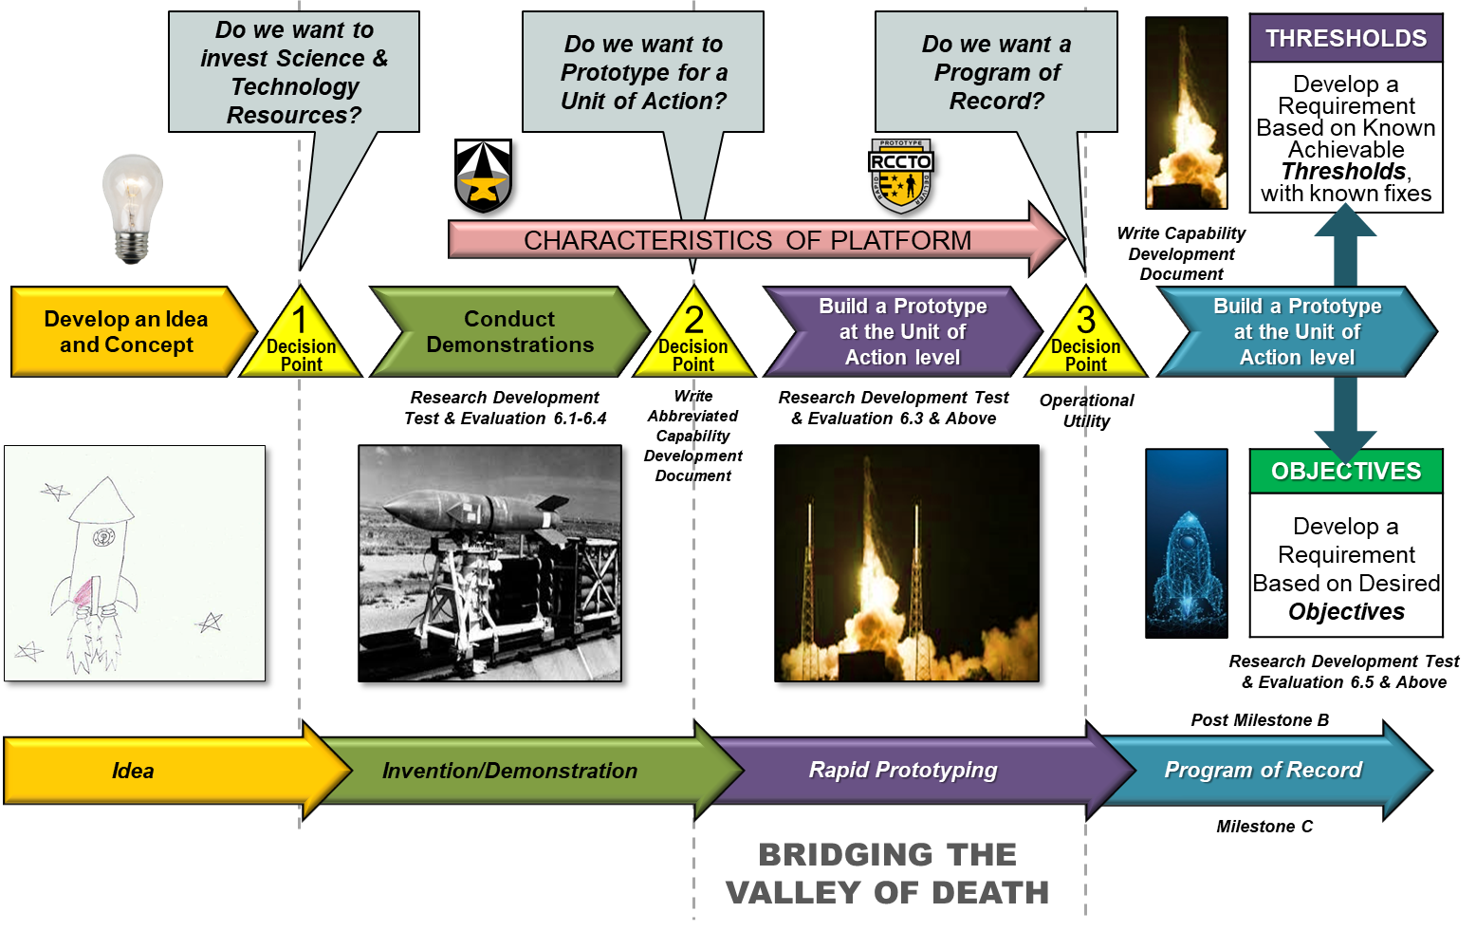
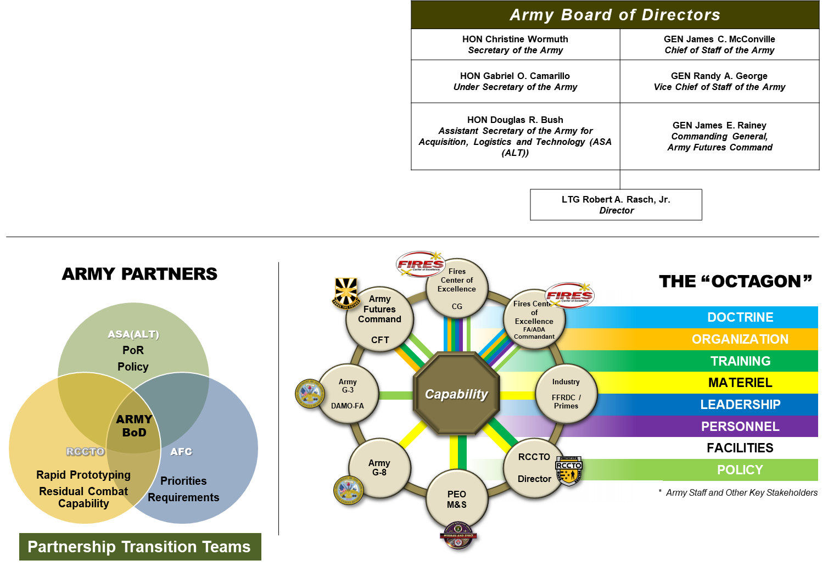
Agenda
RCCTO Prototyping Updates
RCCTO “Tomorrow”
As of 01 AUG 2023

Slide 3
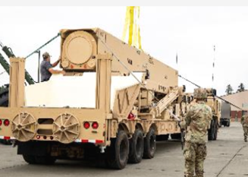
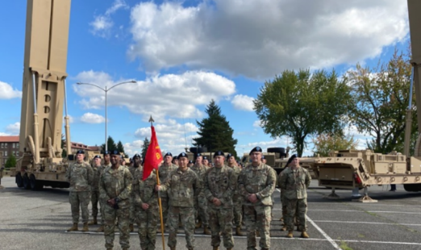
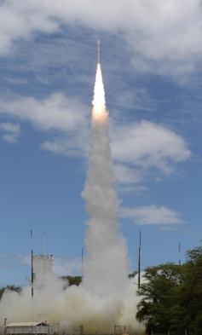
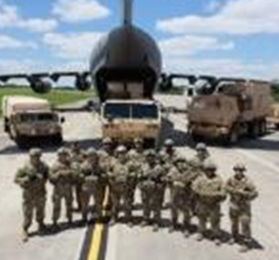
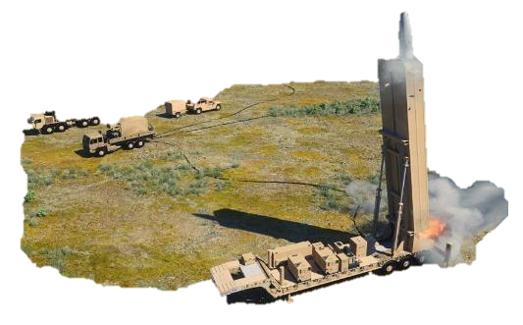
Long Range Hypersonic Weapon
Where we have been:
Developed, delivered first LRHW Battery’s equipment.
Where we are going:
Prepare for next Joint Flight Campaign test with Navy Conventional Prompt Strike program.
Complete unit certification and flight test activities.
Provide first combat capability, i.e., Battery #1.
Complete delivery of missiles for Battery #1.
Transition to PEO M&S and Program of Record.
Deliver Battery #2 and Battery #3.
Technology Insertions (TIs).

Slide 4
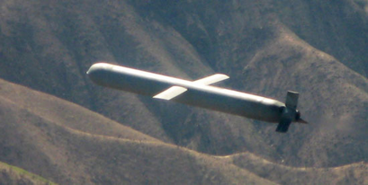
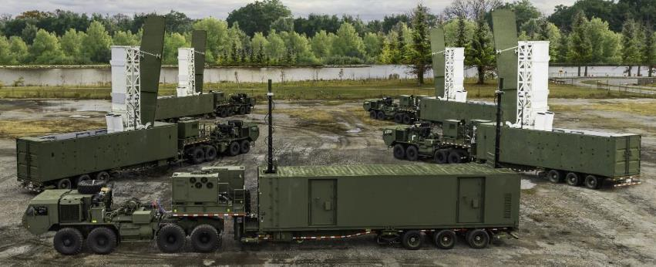
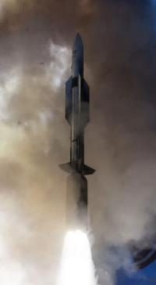
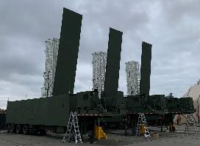
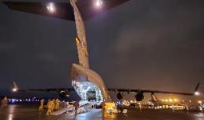
Mid-Range Capability
Where we have been:
Developed, delivered first MRC Battery’s equipment.
Munitions delivered to Battery #1.
Where we are going:
Transition to PEO M&S and Program of Record.
Deliver Batteries #2-5.

Slide 5
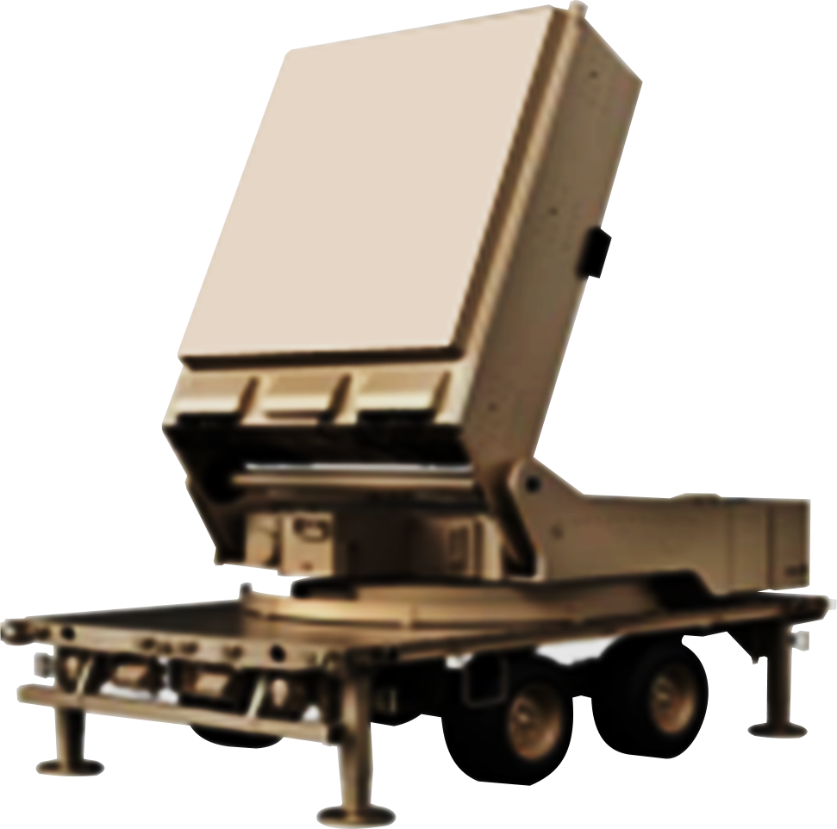
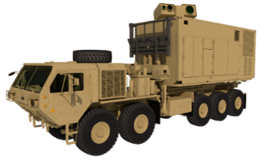
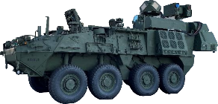
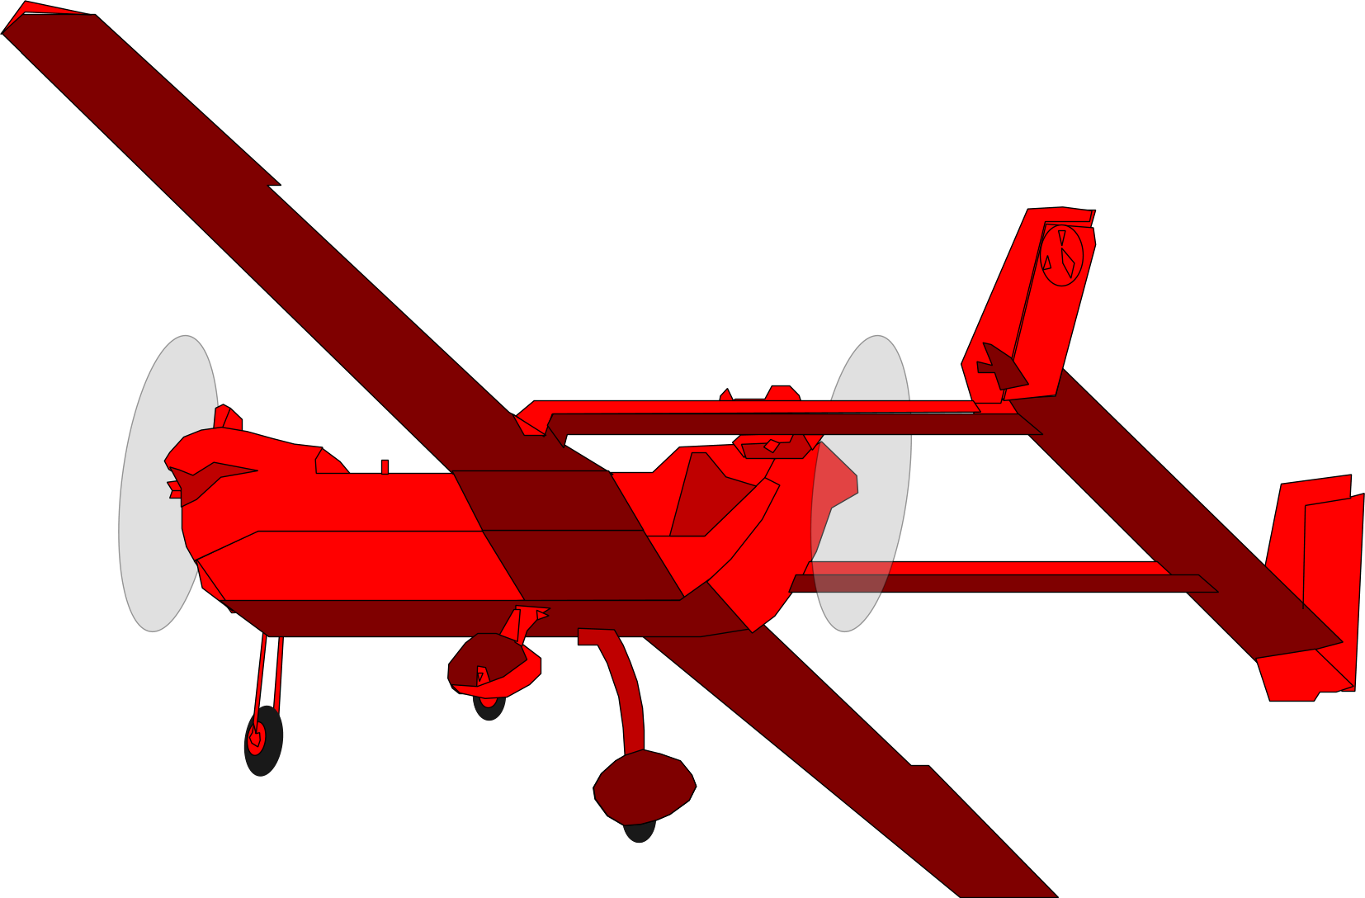
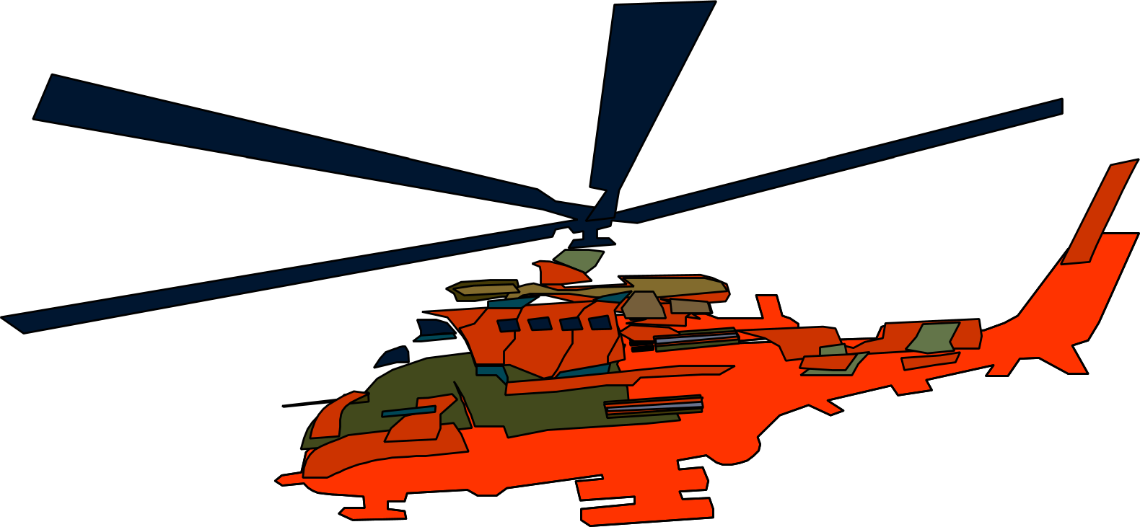
Directed Energy Prototypes
Maneuver Air Defense
Fixed Base Defense
Directed Energy Maneuver-Short Range Air Defense
Indirect Fire Protection Capability - High Energy Laser
Indirect Fire Protection Capability
-High Power Microwave
Notional Depiction
Notional Depiction
50kW-class laser weapon
300kW-class laser weapon
High power microwave weapon
Maneuver force protection against aerial threats
Fixed and semi-fixed site protection against aerial threats
Fixed site protection against swarming threats
Threat Set
Threat Set
Threat Set
Groups 1-3 Unmanned Aircraft Systems
Rockets, Artillery, Mortars
Groups 1-3 Unmanned Aircraft Systems
Rockets, Artillery, Mortars
Groups 1-2 Unmanned Aircraft Systems and Swarms
Rotary-Wing
Rotary-Wing
Cruise Missiles
Fixed Wing
Where we have been:
Delivered 2 systems.
Where we are going:
Deliver #3 and 4.
Transition to PEO MS.
Where we have been:
Contract awarded for 2 systems.
Where we are going:
Deliver 2 systems
Where we have been:
Contract awarded for 4 systems.
Where we are going:
Deliver 4 systems.

Slide 6
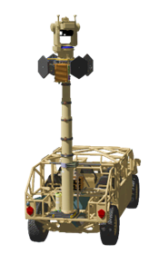
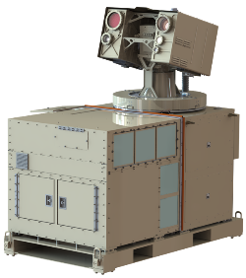
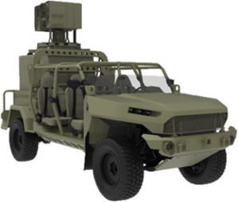
Counter-small Unmanned Aircraft Systems Prototypes
Maneuver / Mobile Air Defense
Fixed / Semi-fixed Base Defense
Army Multi-Purpose High Energy Laser
Family of Counter Unmanned Aircraft Systems
Palletized-High Energy Laser
Notional Depiction
Notional Depiction
Notional Depiction
Palletized 10kW and 20kW
laser weapon
20kW-class laser weapon
Passive sensors with weapons
Maneuver force protection against unmanned aerial threats
Maneuver force protection against unmanned aerial threats
Force protection against unmanned aerial threats
Threat Set
Threat Set
Threat Set
Groups 1-2 Unmanned Aircraft Systems
Groups 1-3 Unmanned Aircraft Systems
Groups 1-2 Unmanned Aircraft Systems
Where we have been:
Acquisition Decision Memorandum.
Preliminary Design Review completed.
Where we are going:
Critical Design Review.
First article delivery and verification.
Deliver 4 systems.
Where we have been:
PC-21 on network, integrated with Fire- storm, showed tracks on main network.
PC-22 sensors tracked class 1 UASs.
Where we are going:
Deliver 6 systems.
Transition to PEO MS.
Where we have been:
Army first: Directed Energy Weapon Approval Process (DEWRAP).
Deployed 3 systems.
Where we are going:
DEWRAP approval.
New equipment training for P-HEL 2 and 3.
In-theater live fire exercise.

Slide 7
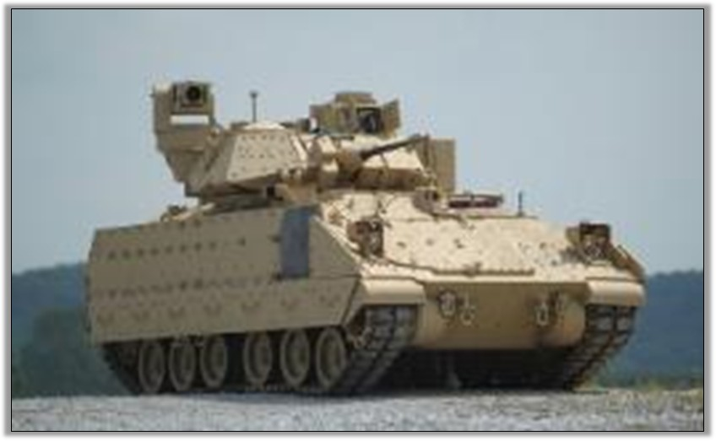
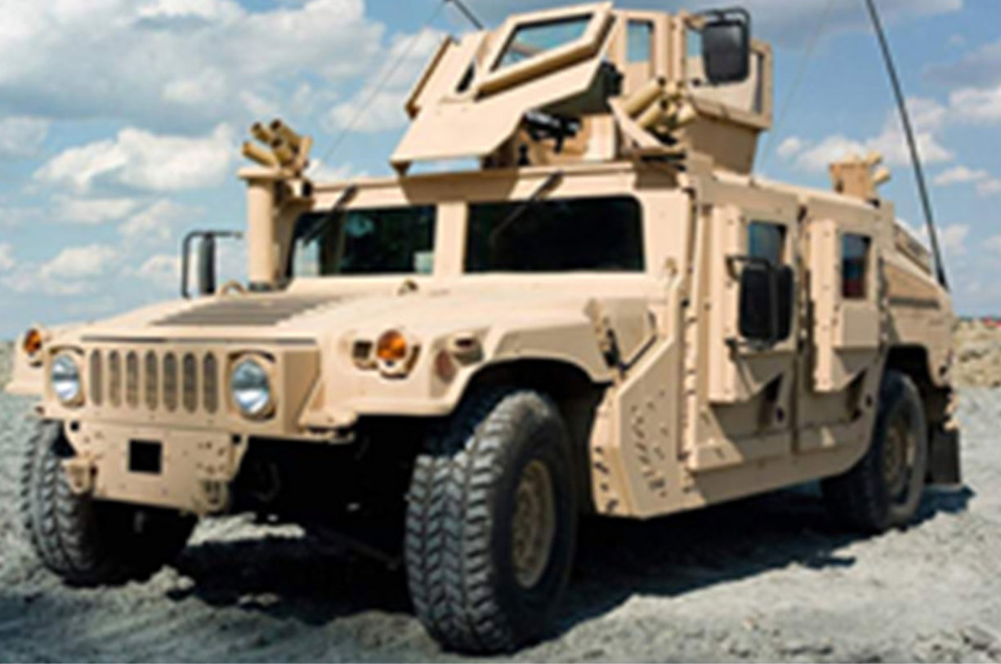
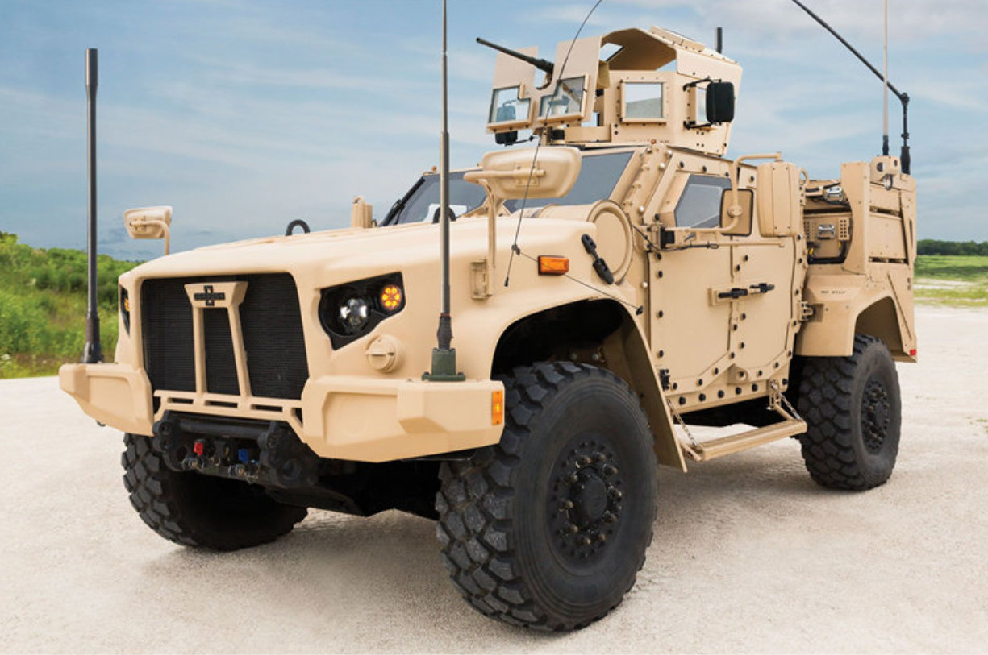
Hybrid Electric Vehicles (HEVs)
Increase operational effectiveness through reduced signatures.
Increase onboard electrical power generation, add off-platform export power capability.
Increase automotive performance.
M2A2 Bradley Fighting Vehicle
M1151 A1 Up-Armored High Mobility Multipurpose Wheeled Vehicle
M1281 Close Combat Weapons Carrier Joint Light Tactical Vehicle
Where we have been:
Bradley HEV: Delivered 2.
HMMWV HEV: Test Readiness Review.
JLTV HEV: Interim Integration and Build completed.
Where we are going:
Bradley HEV: Transfer knowledge to PEO GCS.
Prototype: 2 X HMMWV HEV, 3 X JLTV HEV, and 4 X Stryker HEV.

Slide 8
Human-Machine Integrated Formations (H-MIF): Leadership Intent
Task: Develop a RCCTO-led, total Army Integrated Solutions Team (IST) developing Human-Machine Integrated Formations (H-MIF), integrating cross-Army autonomous and robotics initiatives into operationally deployable prototypes.
Intent
Initial Formation(s)
Deliverables
Focus on Human-Machine Integration, not Human-Machine Teaming
Optimize capabilities of both Human and Machine
Formation-based Thinking
Place into the hands of Soldiers to receive innovation feedback
Start small (1-2 PLTs) of Mechanized and Light, then scale to other formations
Pull From Enterprise:
Initial Platforms(s)
Initial Payload(s)
Autonomous Behaviors
Rapid Prototyping:
Additional Platforms
H-MIF Architecture
Resilient Network/Enablers
Integrated Formation Capabilities
Enhanced Platforms / Payloads/Behaviors
ABCT
IBCT
HEAVY & LIGHT
4x Robots
2x Control Vehicles
“Think big, start small, go fast!”

Slide 9
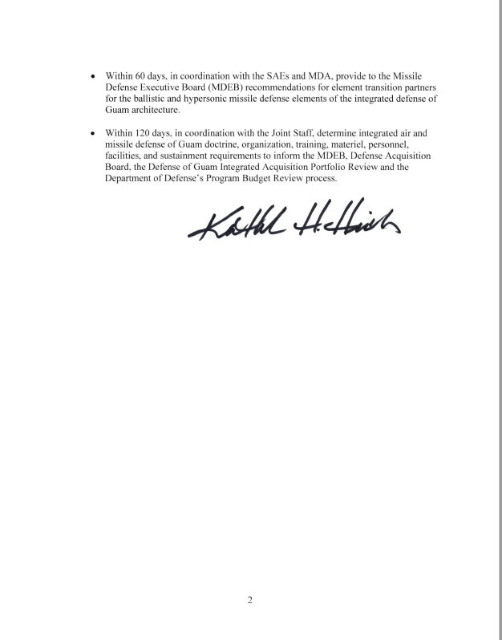
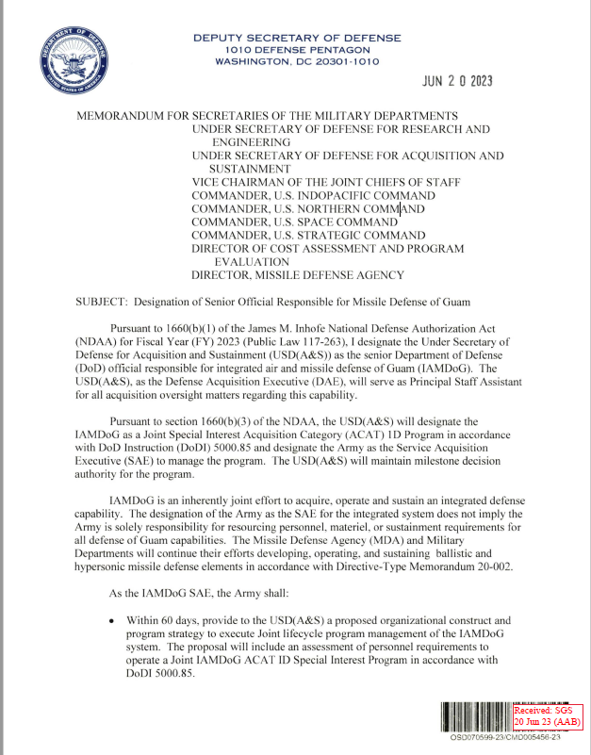
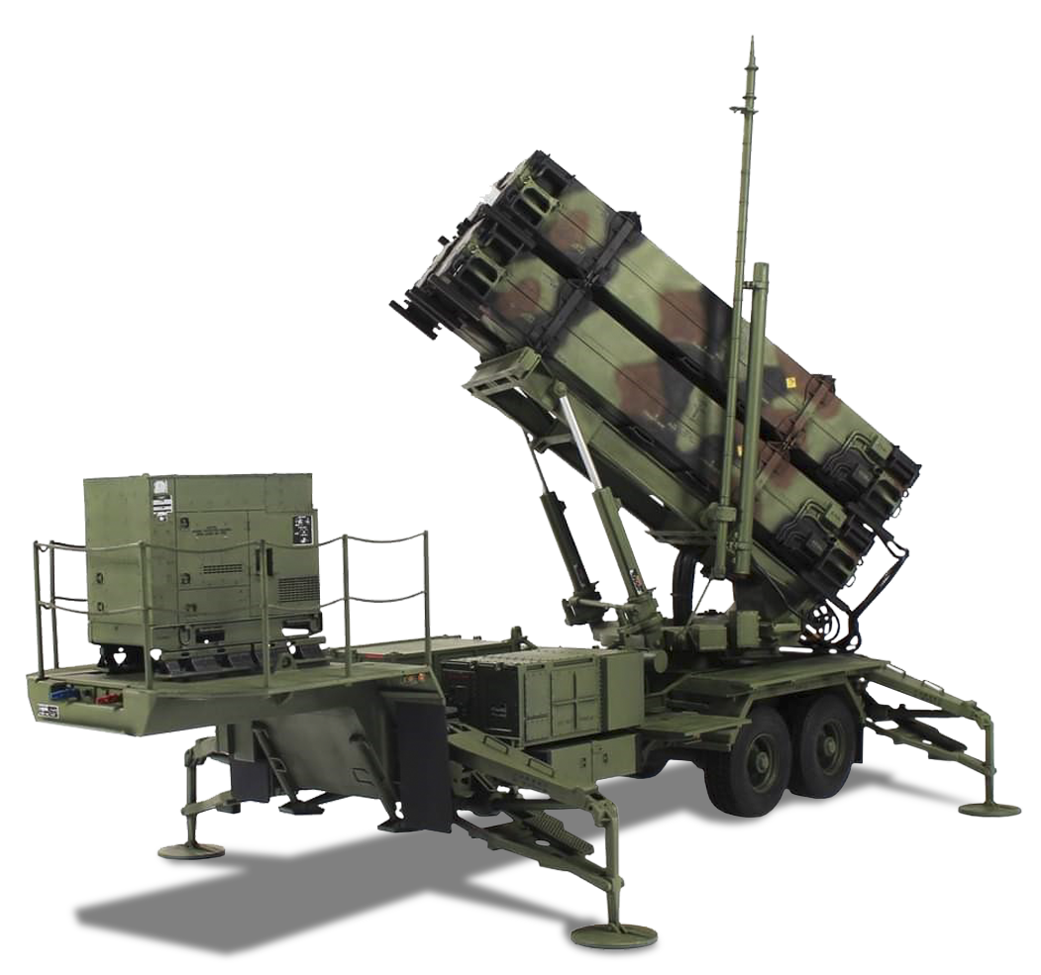
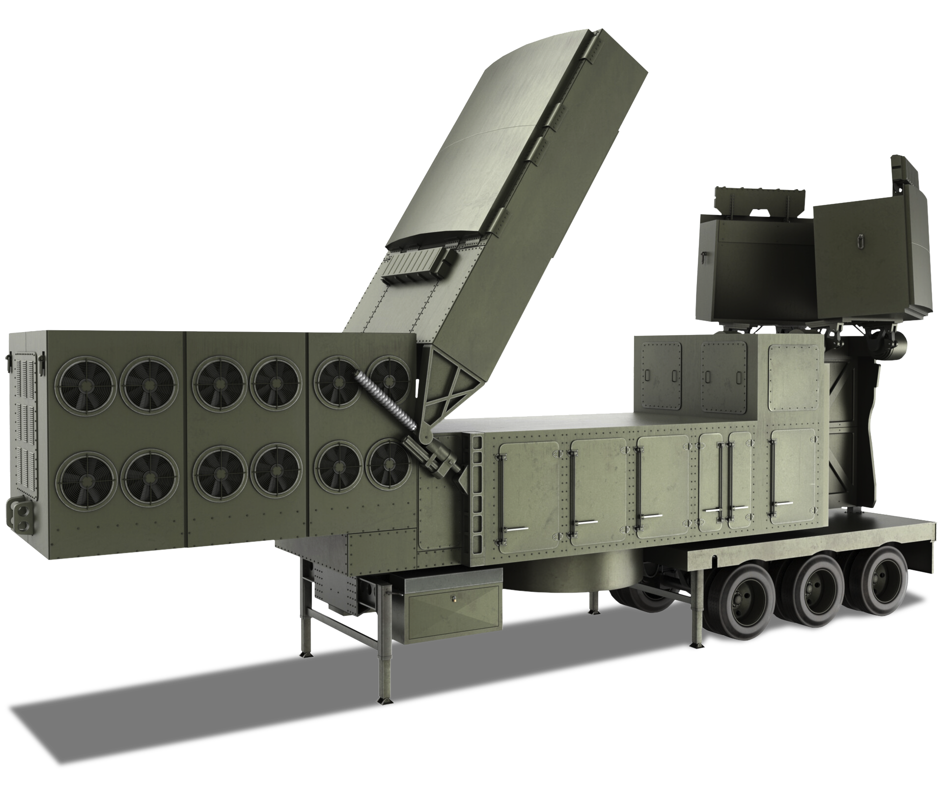
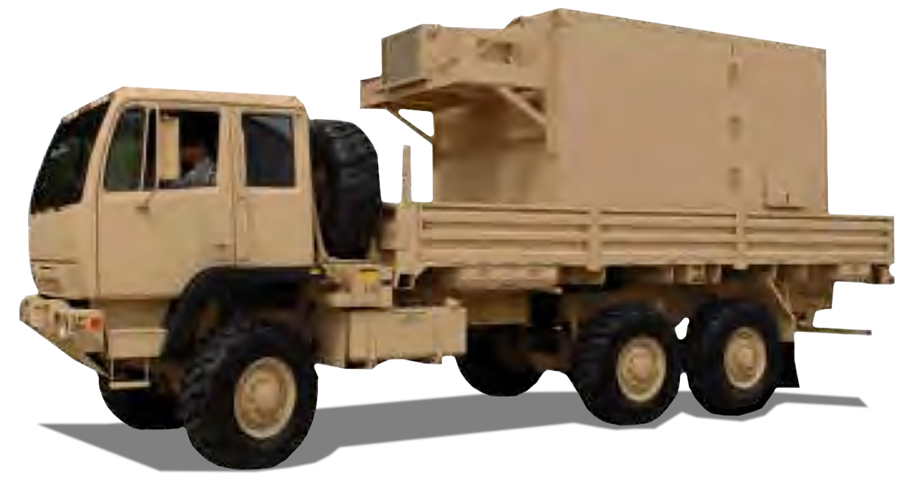
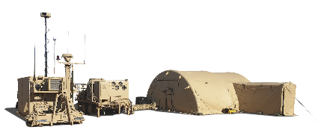
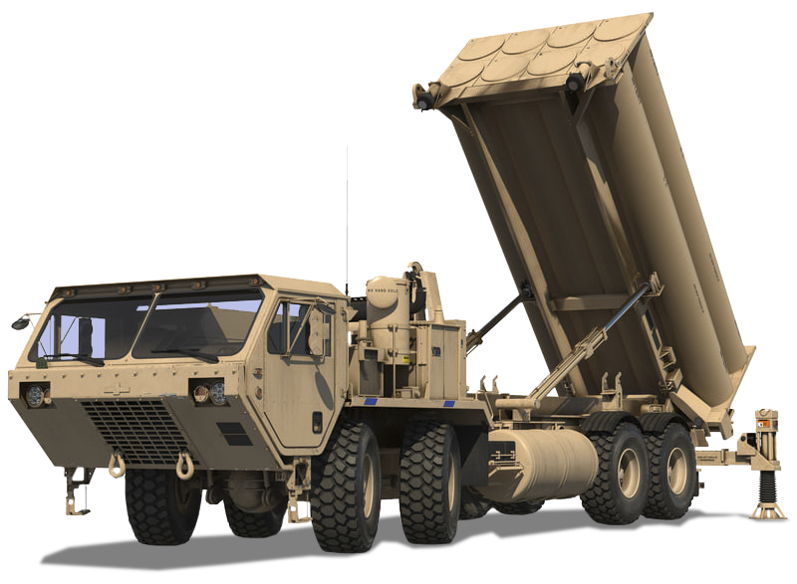
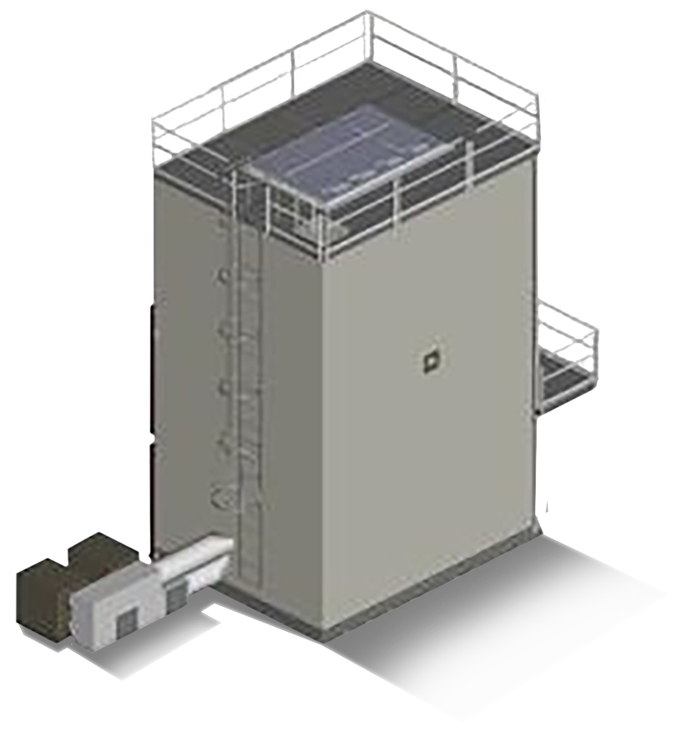
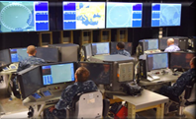
Integrated Air and Missile Defense of Guam (IAMDoG)
Defense Acquisition Executive (DAE) / Senior Designated Official USD (A&S)
Service Acquisition Executive (SAE) Lead Service
USD(A&S) is the senior DoD official responsible for IAMDoG.
USD(A&S) will designate IAMDoG as a Joint Special Interest ACAT 1D program.
The Army is the Service Acquisition Executive managing the program.
Joint Program Office Guam Defense System – ACAT 1D
MDA
USSF
USA
USAF
USN

Slide 10
IAMDoG Joint Program Office Mission
MISSION: Integrate Service and Agency elements into a unified air and missile defense capability to defeat hypersonic, ballistic, cruise missiles, and aerial threats.

Slide 11
Questions?

